Slide 1
WORDZONE
Capstone Project
Presenter –
Ritveak dugar – 16bit0407

Slide 2
What is WordZone?
It is a place where user can execute multiple word related queries and by using the data generated by the user, Wordzone suggests new words to the user to learn.
It is a place where one can Find, understand, know and Learn words.
And hence it is a playground where users can explore and improve their vocabulary

Slide 3
What does it have?
It has Four parts:
Find Zone - Where user can find words for crossword, scrabble and rhymes.
Understand Zone – Where user can understand their word.
Knowledge Zone – Where user can know more words related to the entered word, like synonyms, antonyms etc.
Learning Zone – Where user can learn new words on the basis of their vocabulary

Slide 4
Tech Stack
PROGRAMMING LANGUAGE :
PYTHON
KIVY
TOOLS AND LIBRARIES:
NLTK
SPELL CHECKER
PRONOUNCING
DATAMUSE AND OXFORD API
WORDFREQ
PICKLE
TRAINING MODEL
LSTM

Slide 5
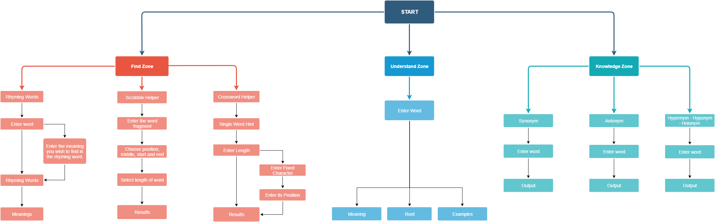
Modules and Detailed workflow

Slide 6
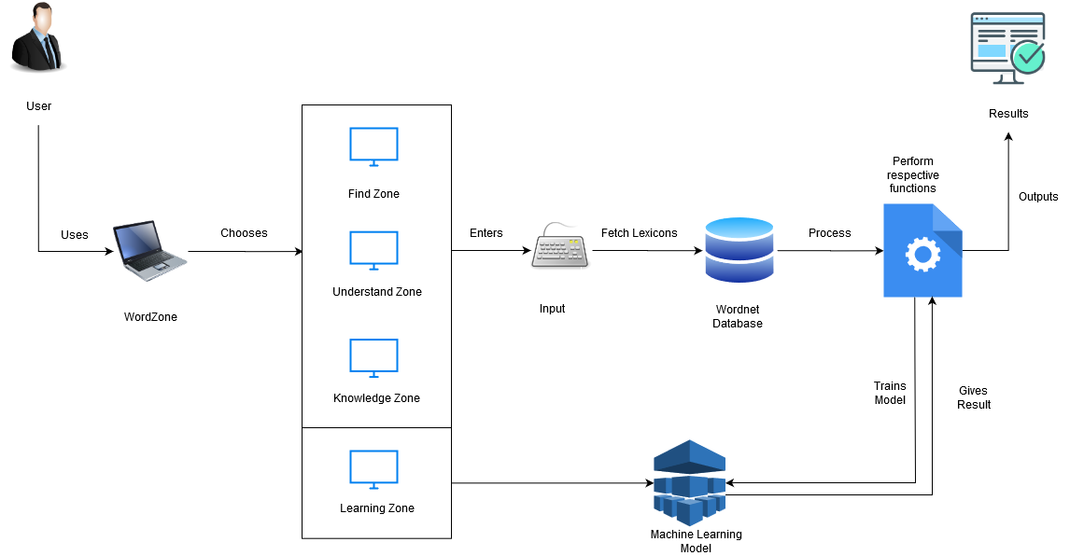
System Architecture:

Slide 7
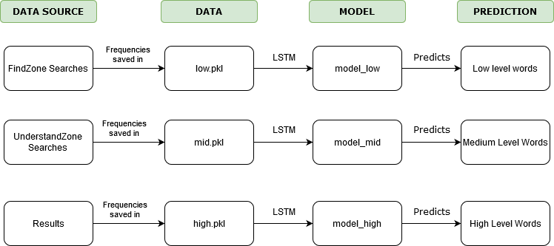
Data Training

Slide 8
Why LSTM
Univariate Time Series Data.
RNN (which is usually the choice for sequential data) had vanishing linear gradient problem and has no control over which part of old data needs to be forgotten.
LSTM uses gated network which helps it avoid both the problems.

Slide 9

Demo Walkthrough of WordZone

Slide 10
RMS Error
Model | RMS Error
Low | 0.5369047
Mid | 0.6762149
High | 1.3645634

Slide 11
Future Work
More details can be shown in the results of each section, like their part of speech and varied usage.
WordZone should be modified in such a way that it auto trains after entry of substantial amount of new data.
Research on whether old data should be deleted or kept for predicting words as per user’s current vocabulary.
Research on finding better feature than frequency of a word in English Language for getting toughness of a word from vocabulary point of view.
Since Kivy can be used for Mobile App development also, making an spp and publishing it is also a viable future work.

Slide 12
THANK YOU

